Slide 1
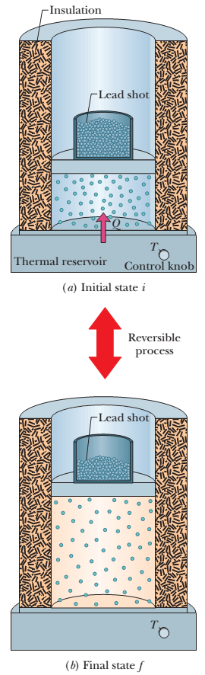

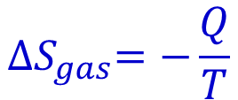
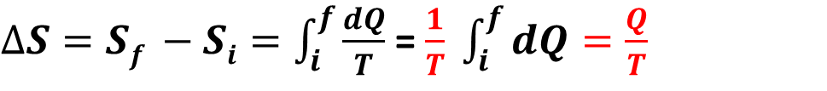
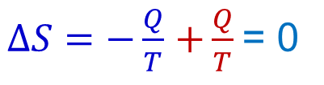
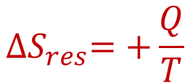
Lecture 10
Chapter 20: Entropy and the second law of thermodynamics
20-1 Second Law of Thermodynamics in terms of Entropy: $∆S≥0$
Reversible process: Let’s check the change in entropy of the enlarged system consisting of gas and reservoir. We can then calculate separately the entropy changes from the following equations.
$∆S=Sf −Si=\int_{i}^{f}{\frac{dQ}{T}}$ = $\frac{1}{T} \int_{i}^{f}{dQ=\frac{Q}{T}}$
$$T=constant$$
$${∆S}_{gas}=−\frac{Q}{T}$$
$${∆S}_{res}=+\frac{Q}{T}$$
$∆S=−\frac{Q}{T}$ $+\frac{Q}{T}$= 0

Slide 2
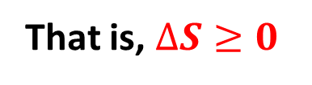
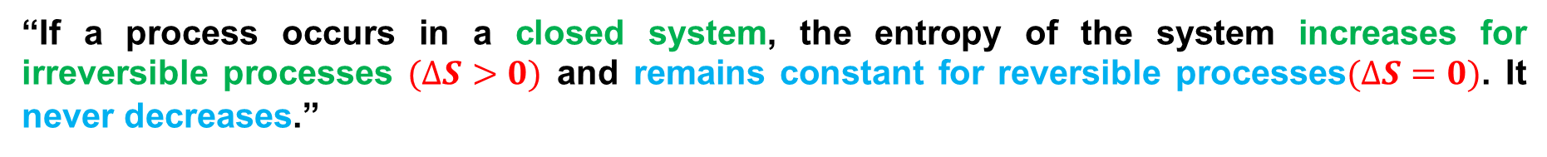
“If a process occurs in a closed system, the entropy of the system increases for irreversible processes $(∆S>0)$ and remains constant for reversible processes$(∆S=0)$. It never decreases.”
That is, $∆S≥0$
In the real world almost all processes are irreversible to some extent because of friction, turbulence, and other factors, so the entropy of real closed systems undergoing real processes always increases. Processes in which the system’s entropy remains constant are always idealizations.

Slide 3
20-2 Entropy in the Real World: Engines
Heat Engine: A heat engine, or more simply, an engine, is a device that extracts energy from its environment in the form of heat and does useful work. At the heart of every engine is a working substance.
Carnot Engine: Although an ideal gas does not exist, any real gas approaches ideal behavior if its density is low enough. Similarly, we can study real engines by analyzing the behavior of an ideal engine.
“An ideal engine where all processes are reversible and no wasteful energy transfers occur due to, say, friction and turbulence”.

Slide 4
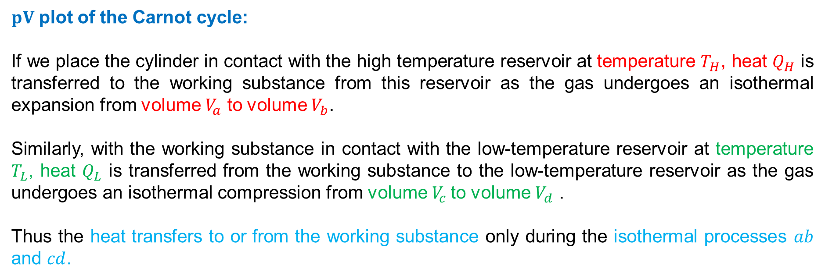
Schematic diagram of a Carnot Engine:
We shall focus on a particular ideal engine called a Carnot engine after the French scientist and engineer N. L. Sadi Carnot (pronounced “cah-no”),who first proposed the engine’s concept in 1824.This ideal engine turns out to be the best (in principle) at using energy as heat to do useful work. Surprisingly, Carnot was able to analyze the performance of this engine before the first law of thermodynamics and the concept of entropy had been discovered.
$pV$ plot of the Carnot cycle:
If we place the cylinder in contact with the high temperature reservoir at temperature $T_{H}$, heat $Q_{H}$ is transferred to the working substance from this reservoir as the gas undergoes an isothermal expansion from volume $V_{a}$ to volume $V_{b}$.
Similarly, with the working substance in contact with the low-temperature reservoir at temperature $T_{L}$, heat $Q_{L}$ is transferred from the working substance to the low-temperature reservoir as the gas undergoes an isothermal compression from volume${ V}_{c}$ to volume $V_{d}$ .
Thus the heat transfers to or from the working substance only during the isothermal processes $ab$ and $cd$.

Slide 5
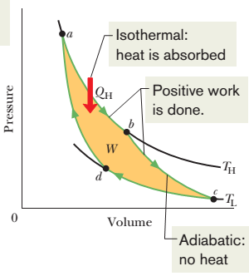
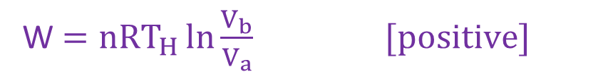
Isothermal expansion at constant T_{H} from a to b states:
Heat Q_{H} is absorbed by the working substance.
Pressure decreases from P_{a} to P_{b}
P_{a}
Volume increases from V_{a} to V_{b}
W $=nRT_{H}\ln{\frac{V_{b}}{V_{a}} [positive] }$
During the processes ab and bc, the working substance is expanding and thus doing positive work as it raises the weighted piston. This work is represented by the area under curve abc.
P_{b}
V_{a}
V_{b}

Slide 6
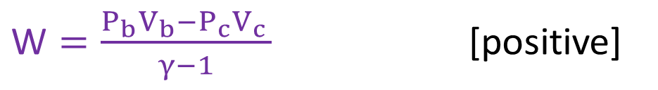
Adiabatic expansion from b to c states:
Heat Q is zero.
Pressure decreases from P_{b} to P_{c}
Volume increases from V_{b} to V_{c}
$\text{W}=\frac{P_{b}V_{b}−P_{c}V_{c }}{γ−1}$ [positive]
P_{b}
P_{c}
V_{c}
V_{b}

Slide 7
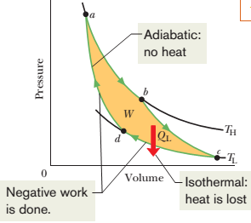
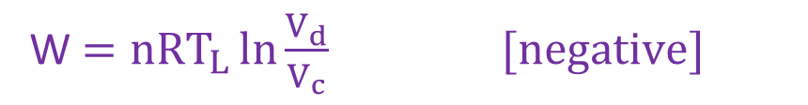
Isothermal compression at constant T_{L} from c to d states:
Heat Q_{L} is released.
Pressure increases from P_{c} to P_{d}
Volume decreases from V_{c} to V_{d}
W $=nRT_{L}\ln{\frac{V_{d}}{V_{c}} [negative] }$
During the processes cd and da, the working substance is being compressed, which means that it is doing negative work on its environment. This work is represented by the area under curve cda.
P_{d}
P_{c}
V_{c}
V_{d}

Slide 8

Adiabatic compression from d to a states:
Heat Q is zero.
P_{a}
Pressure increases from P_{d} to P_{a}
Volume decreases from V_{d} to V_{a}
$\text{W}=\frac{P_{d}V_{d}−P_{a}V_{a }}{γ−1}$ [negative]
P_{d}
V_{a}
V_{d}

Slide 9
Carnot cycle:
W = abcda area inside the curve [positive]
The net work per cycle is the difference between these two areas and is a positive quantity equal to the area enclosed by cycle abcda (yellow area).

Slide 10
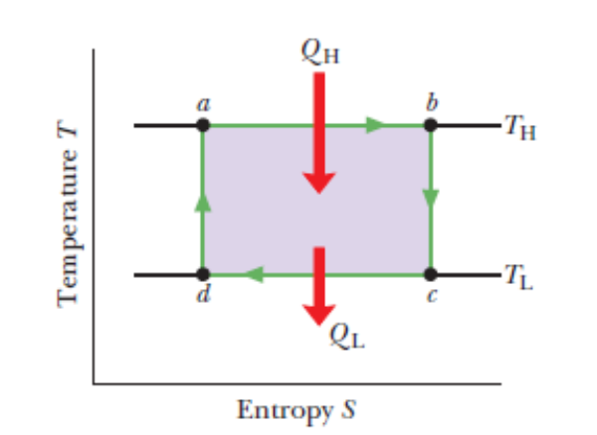
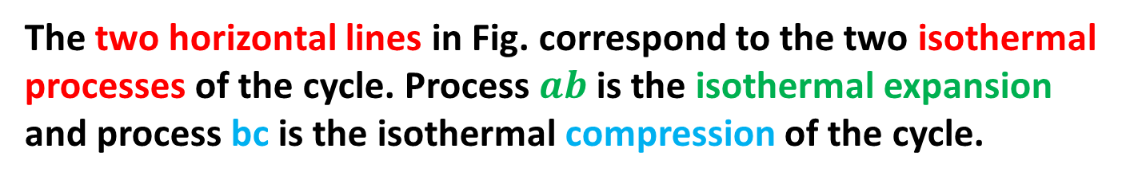
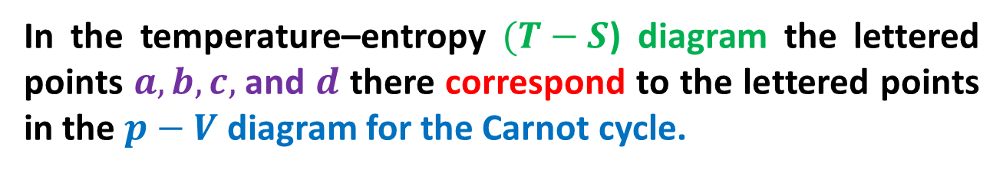






Carnot cycle on a temperature–entropy diagram
$$∆S=\frac{+QH}{TH}$$
In the temperature–entropy $(T−S$) diagram the lettered points $a, b, c,$and $d$ there correspond to the lettered points in the $p−V$ diagram for the Carnot cycle.
$$∆S=Sc −Sb=10−10=0$$
The two horizontal lines in Fig. correspond to the two isothermal processes of the cycle. Process $ab$ is the isothermal expansion and process bc is the isothermal compression of the cycle.
$$∆S=\frac{−QL}{TH}$$
As the working substance (reversibly) absorbs energy $Q_{H}$ as heat at constant temperature $T_{H}$ during the expansion, its entropy increases.
$$∆S=\frac{+Q}{T}$$
Similarly, during the isothermal compression $cd$, the working substance (reversibly) loses energy $Q_{L}$ as heat at constant temperature $T_{L}$, and its entropy decreases.
$$∆S=\frac{−Q}{T}$$
The two vertical lines correspond to the two adiabatic processes of the Carnot cycle. Because no energy is transferred as heat during the two processes (Q = 0), the entropy of the working substance is constant during them.
$$∆S=0$$

Slide 11
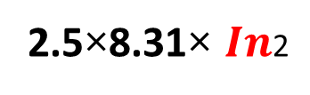
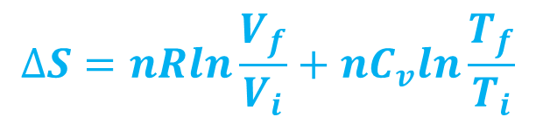
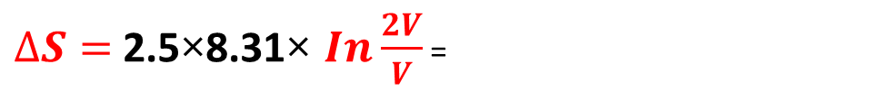

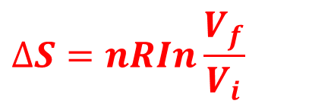
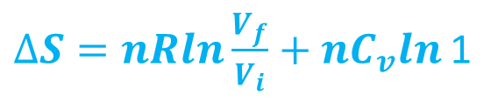
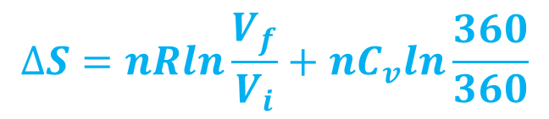
3. A 2.50 mol sample of an ideal gas expands reversibly and isothermally at 360 K until its volume is doubled. What is the increase in entropy of the gas?
$$∆S=nRln\frac{V_{f}}{V_{i}}+nC_{v}ln\frac{T_{f}}{T_{i}}$$
Solution:
$$∆S=nRln\frac{V_{f}}{V_{i}}+nC_{v}ln\frac{360}{360}$$
$∆S=nRln\frac{V_{f}}{V_{i}}+nC_{v}ln$ 1
$$∆S=nRIn\frac{V_{f}}{V_{i}}$$
$∆S=$ 2.5×8.31× $In\frac{2V}{V}$ =
2.5×8.31× $In$2
$∆S=$ 14.4 J/K (Answer)

Slide 12
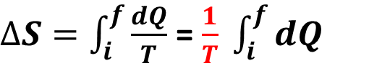
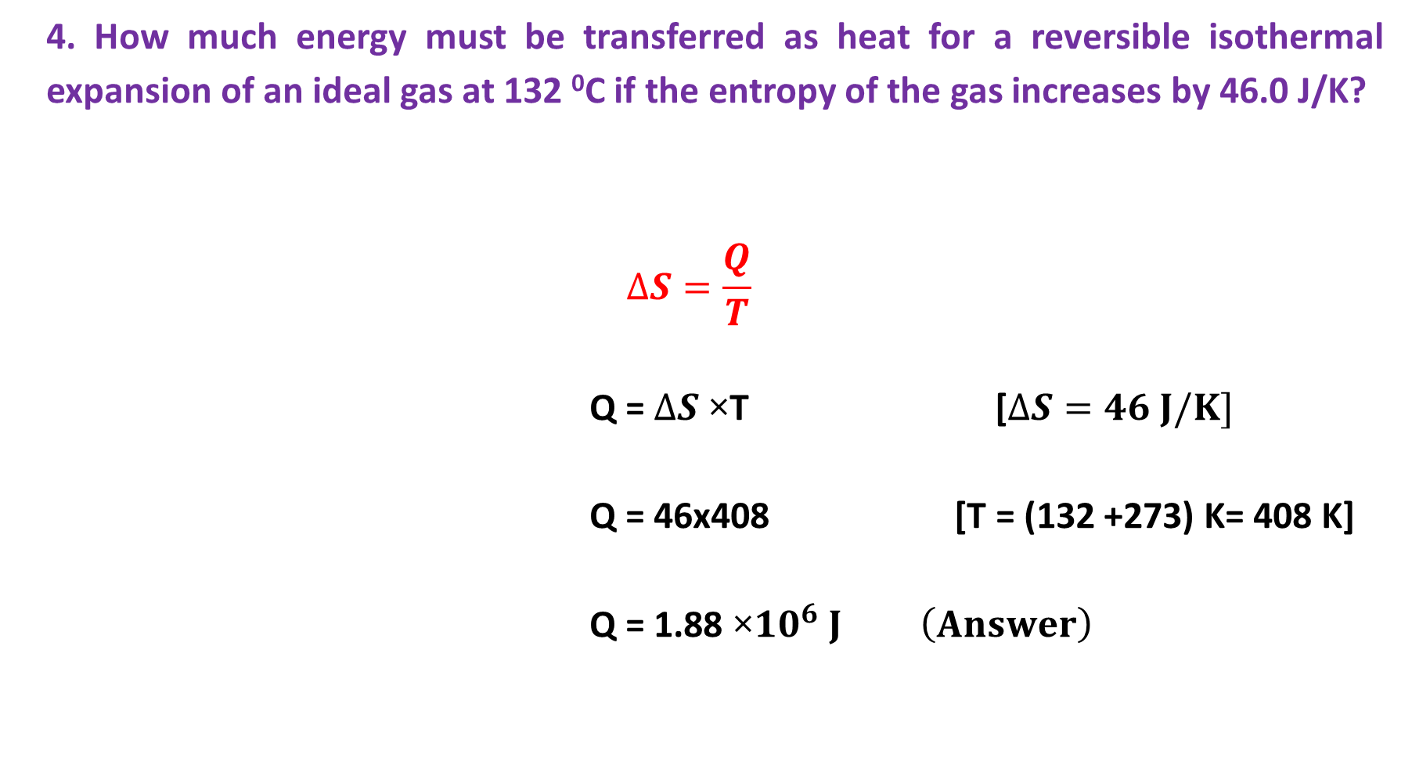
4. How much energy must be transferred as heat for a reversible isothermal expansion of an ideal gas at 132 ⁰C if the entropy of the gas increases by 46.0 J/K?
$$∆S=\frac{Q}{T}$$
Q = $∆S$ ×T [$∆S=46 J/K]$
Q = 46x408 [T = (132 +273) K= 408 K]
Q = 1.88 ×${10}^{6} J \left(Answer\right)$
Solution:
$∆S=\int_{i}^{f}{\frac{dQ}{T}}$ = $\frac{1}{T} \int_{i}^{f}{dQ}$

